Slide 1
North Atlantic Bloom 2008
Webinar series
Ivona Cetinić, Carla Companion, Annette deCharon, Christy Herren,
Eric D'Asaro, Craig Lee, Amala Mahadevan, Melissa Omand,
Mary Jane Perry, Nicole Poulton
University of Maine, COSEE Ocean Systems, University of Washington,
Woods Hole Oceanographic Institution, Bigelow Laboratory for Ocean Sciences

Slide 2
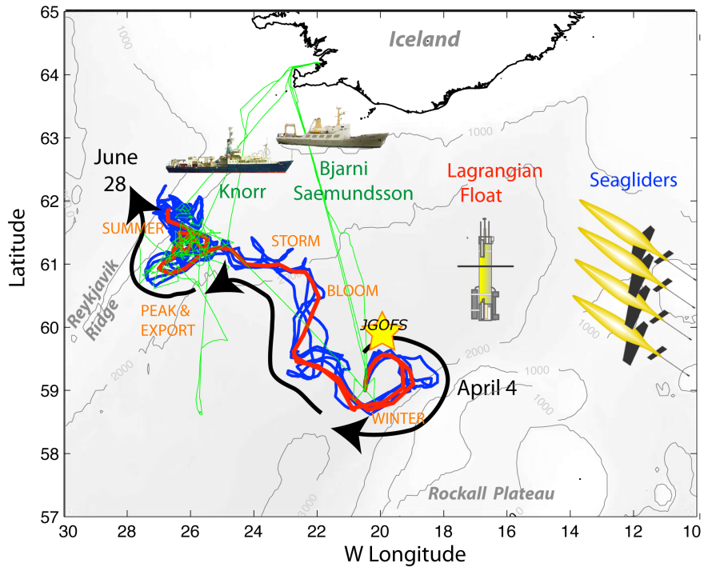
The 2008 North Atlantic Bloom Experiment: Autonomous Sampling in a Lagrangian Frame
Bloom Dynamics
Carbon cycle associated mechanisms
Climate change…
Early April
Float and glider deployment
May
Process cruise
June
Recover floats and gliders
4 cruises
70 float-days
340 glider-days
100 channels of realtime data
Alkire et al., in press

Slide 3
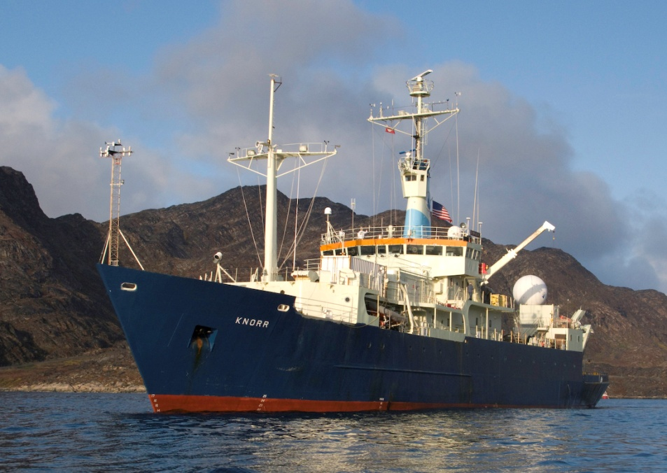
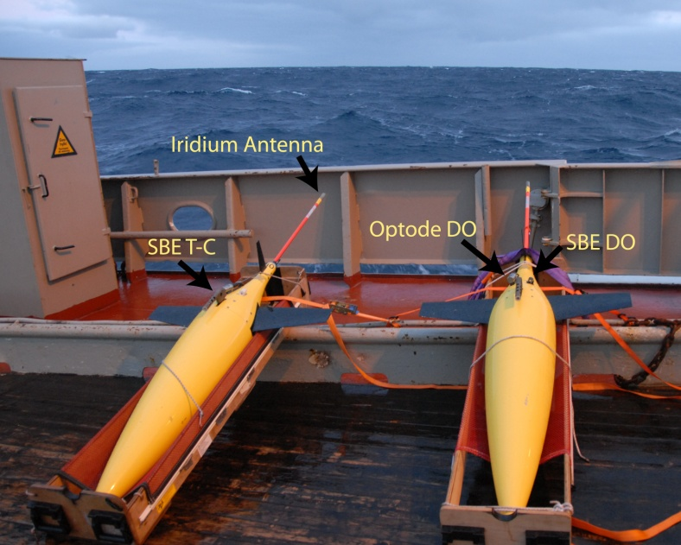
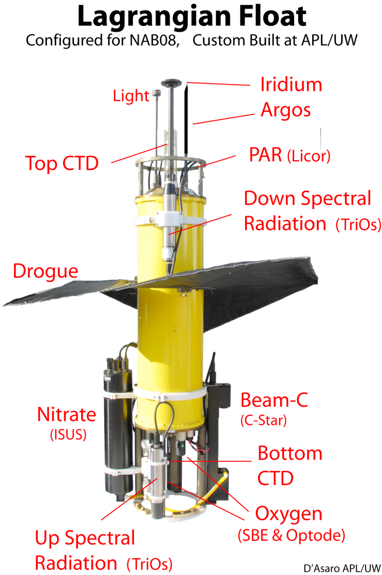
Gliders- Survey around floats. Profile to 1000 m every 4-5 h.
R/V Knorr
R/V Sæmundsson
Extensive biological and chemical measurements, calibration data,
scale check
Lagrangian Float
Cycle within mixed layer. Profile to 250 m every 24-36 h.

Slide 4
Collaboration with Center for Ocean Sciences Education Excellence (COSEE) - Ocean Systems
To broadly disseminate results and contribute to the public’s understanding of ocean science, NAB08 participants collaborated with the COSEE - Ocean Systems
Identified five theme areas to fit a five-part webinar series
Invited/involved seven presenters from four institutions
Included efforts to make the series a connected story
Targeted audience:
middle school and high school educators (both formal and informal)

Slide 5
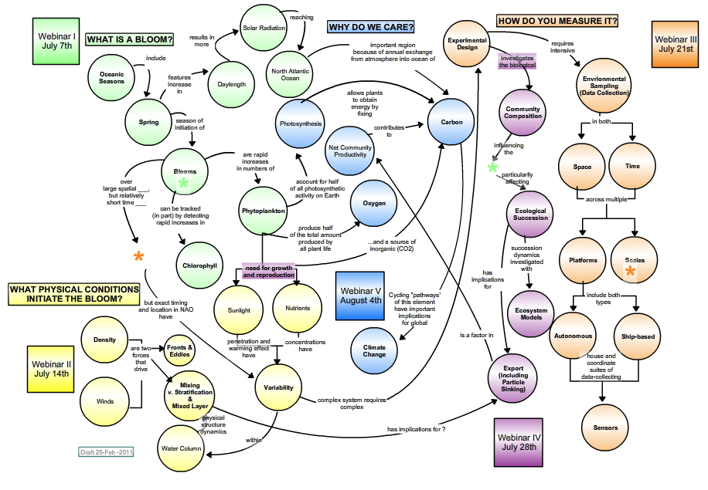
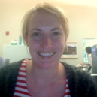
NAB08 ………. a connected story

Slide 6
Webinar
Presentation
Concept map
Interactive Q&A
Dataset

Slide 7
Webinar - Concept map
Emphasizes key concepts and the connections between concepts
Relates specific topics to the “big picture”
Non-linear presentation that is adjustable to an audience’s prior knowledge
Numerous assets that can be linked to a specific “concept”
Provides a visual overview to orient an audience and help the presenter field questions

Slide 8
Webinar
Presentation
Interactive Q&A
Dataset
Source: NASA

Slide 9
Webinar
The last graph you showed, you suggested that the “dips” in chlorophyll on that graph were due to mixing -by storms- taking some of the algae that were up in the ‘measured point’ in the water, I guess, - taking them out of that area because of the mixing. Is that correct?
Presentation
Interactive
Q&A
Dataset
Did you use satellite imagery to determine where to release the floats and seagliders in order to get the best data possible?
Where do these phytoplankton that are in the spring bloom go over the winter? If they all die, are there seeds or something that allow them to come back next year?
Is anything measured in the North Atlantic bloom experiment being used to improve climate models?
How can you apply all this data that we’re getting to help the average person? Is that a possibility?
Is there any other study that has been done in any other part of the global ocean that could be used in a classroom to compare with what you all have seen compared to what they’ve seen?

Slide 10
Webinar
Dataset contains (Excel):
CTD Tools and Sensors
Float Tools and Sensors
Glossary
CTD Dataset
Float Dataset
Example of Plots CTD
Example of Plots Float
Related Data-Based Activity
Growth & Loss (Exponentials)
Mixed Layer Depth
Temporal and Spatial Scales
Phytoplankton Composition and Nutrients
Density and Deep Convection
Presentation
Interactive Q&A
Dataset

Slide 11
Webinar
Presentation
Interactive Q&A
Dataset
Physics of the bloom
by Amala Mahadevan and Melissa Omand (WHOI)
Light vs. depth
Phytoplankton vs. time

Slide 12
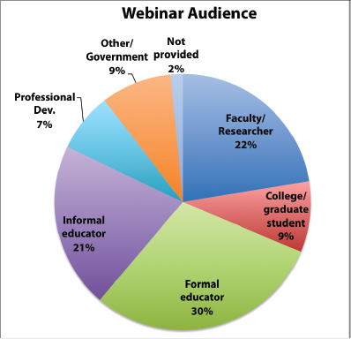
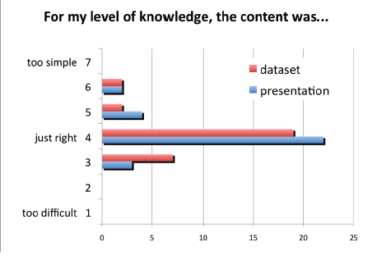
Outcomes
68 unique participants from 21 states (+ Canada, Iceland and Germany)
51 % educators,
31 % scientists/grad students
Average 28 participants/webinar
high “return rate” – over 30% attended three or more live webinars in the series.
Other metrics:
Second (to home page) most viewed page on the OS site (since the series began in July 2011)

Slide 13
Outcomes – all materials archived @ http://cosee.umaine.edu/programs/webinars/nab
Transcripts
Videos
Interactive concept maps
Assets
(figures, photos, videos)
Dataset
( + video
walk-though)

Slide 14
Outcomes (scientists perspective)
Source: COSEE-OS

Slide 15
Thank you for your attention
For more details, videos, transcripts and dataset – @ COSEE-OS:
http://cosee.umaine.edu/programs/webinars/nab
Complete NAB08 dataset @ BCO-DMO:
http://osprey.bcodmo.org/project.cfm?flag=view&id=102&sortby=project
Funding graciously provided by:
NSF

